Slide 1
Grain Graphs: OpenMP Performance Analysis Made Easy
Authors: Ananya Muddukrishna, Peter A. Jonsson, Artur Podobas, Mats Brorsson
Affiliate: KTH Royal Institute of Technology, SICS Swedish ICT AB
Published in: Principles and Practice of Parallel Programming (PPoPP’16 CCF A)
Presented by: Junpeng Zhu （朱君鹏）
Advisor: Yin Qian
June 6, 2019

Slide 2


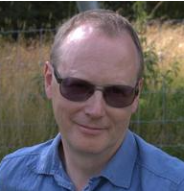
Authors
Now: Postdoctoral Researcher
Education: PhD degree from KTH-ICT
Interests:
OpenMP Programs
Now: Postdoctoral Researcher
Education: Tokyo Institute of Technology
Interests:
Parallel Programming
OpenMP Programs
GPU Programs
Now: Professor in KTH
Educations: Ph.D. , M.S. KTH
Interests:
Parallel Computing
Energy aware computer architecture
Visualization and tool support for performance debugging

Slide 3
OUTLINE
Introduction
Needs for Grain Graphs
Grain Graphs Structure and Metrics
Experiments & Evaluation
Conclusions

Slide 4
Introduction
Existing performance analysis tools visualize OpenMP task performance from the runtime system’s perspective where task execution is interleaved with other tasks in an unpredictable order.
Problems with OpenMP parallel for-loops are similarly difficult to resolve since tools only visualize aggregate thread-level statistics such as load imbalance without zooming into a per-chunk granularity.

Slide 5
Introduction
The runtime system/threads oriented visualization provides poor support for understanding problems with task and chunk execution time, parallelism, and memory hierarchy utilization, forcing average programmers to rely on experts or use tedious trial-and-error tuning methods for performance.

Slide 6
Introduction
The paper presents grain graphs, a new OpenMP performance analysis method that visualizes grains – computation performed by a task or a parallel for-loop chunk instance – and highlights problems such as low parallelism, work inflation and poor parallelization benefit at the grain level.
Parallel for-loop have been in OpenMP since version 1.0 and tasks were introduced in 2008 as fork-join programming constructs in OpenMP 3.0.

Slide 7
Introduction
The grain graphs can quickly reveal performance problems
It is difficult to detect and characterize in fine detail using existing visualizations in standard OpenMP programs, simplifying OpenMP performance analysis.
This enables average programmers to make portable optimizations for poor performing OpenMP programs, reducing pressure on experts and removing the need for tedious trialand-error tuning.

Slide 8
OUTLINE
Introduction
Needs for Grain Graphs
Grain Graphs Structure and Metrics
Experiments & Evaluation
Conclusions

Slide 9
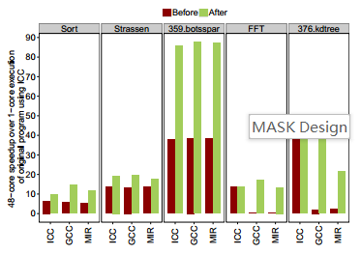
Needs for Grain Graphs
376.kdtree is a fork-join task-based program from SPEC OMP 2012 that searches a k-d tree for neighboring points within a radius.

Slide 10
Needs for Grain Graphs
Grain graphs place parent and child grains in close proximity using creation edges, without timing as a placement constraint.
Inspecting kdnode::sweeptree(), the function that sweeps the tree, shows that the depth is not incremented for recursive calls which explains the large number (1488595) of tasks created for the SPEC reference input.

Slide 11
Needs for Grain Graphs
Incrementing the depth for recursive calls and separating the sweep cutoff from the original cutoff improves performance.
The ICC runtime system overcomes the faulty cutoff in the original program and performs well by using an internal cutoff to limit the number of the tasks.
The missing depth increment escaped both the programmer and SPEC quality control for over three years. Our method reveals structural anomalies that can cripple performance.

Slide 12
OUTLINE
Introduction
Needs for Grain Graphs
Grain Graphs Structure and Metrics
Experiments & Evaluation
Conclusions

Slide 13
Grain Graphs Structure
The grain graph is a directed acyclic graph (DAG) that captures the order of creation and synchronization between grains.
A grain denotes the computation performed by a task or a parallel for-loop chunk instance.
The grain graph consists of five types of nodes – fragment, fork, join, book-keeping nodes, and chunk nodes.

Slide 14
Grain Graphs Structure
Fragment nodes denote the execution of a task between its creation and synchronization.
Green fork nodes denote task creation and orange join nodes denotes task synchronization.
Book-keeping nodes represent computation performed by threads to divide the iteration space and assign iterations to themselves in chunks.

Slide 15
Grain Graphs Structure
Chunk nodes denote computation performed by the set of iterations assigned to chunks.
Fragment nodes, book-keeping nodes, and chunk nodes are weighted with metrics measured during execution.

Slide 16
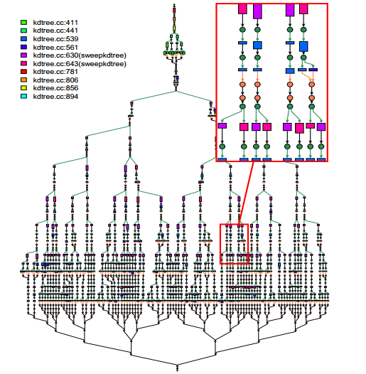
Grain Graphs Structure

Slide 17
Grain Graphs Structure
The grain graph has three types of control-flow edges – creation, synchronization and continuation.
Green creation edges connect a fork node to the first fragment node of a child.
Orange join edges connect the last fragment of children synchronizing with the parent.

Slide 18
Grain Graphs Structure
Black continuation edges connect fragments to fork or join nodes and denote continuation of execution after spawning children or synchronizing with children.

Slide 19
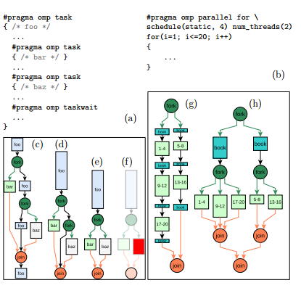
Grain Graphs Structure

Slide 20
Grain Graphs Structure
Task-based OpenMP program. Task foo creates tasks bar and baz, performs computation inbetween and synchronizes with the children tasks.
OpenMP program with parallel for-loop. Iteration space is divided into 5 chunks of size 4 and distributed evenly on two threads.

Slide 21
Grain Graphs Structure
Grain graph captures task creation and synchronization during program execution. Performance of individual task instances are visually encoded so execution time is encoded as the length of fragments. Fragments of foo are sequentially aligned and child fragments are drawn local to the parent context to preserve the program perspective.

Slide 22
Grain Graphs Structure
Reductions group nodes to reduce the size of the graph for quick rendering. Fragment reduction combines task fragments.
Problematic grains are highlighted with a color that reflects severity and remaining elements are dimmed.
Execution of for-loop on two threads. Turquoise nodes represent book-keeping for delivering chunks to threads. Green rectangles show chunk execution labeled with the iteration range.

Slide 23
Grain Graphs Metrics
Parallel benefit: is a grain’s execution time divided by the parallelization costs borne by the grain’s parent.
Load balance: is the ratio between the length of the longest grain and the median length of all chains of consecutive grains in the unreduced graph.
Work deviation: is the change in execution time between single core and multicore grain execution.

Slide 24
Grain Graphs Metrics
Instantaneous parallelism: is parallelism exposed by the program at different times during execution.
Scatter: is the median pair-wise distance in the system topology between cores executing sibling grains.

Slide 25
OUTLINE
Introduction
Needs for Grain Graphs
Grain Graphs Structure and Metrics
Experiments & Evaluation
Conclusions

Slide 26
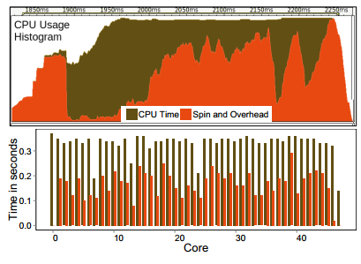
Experiments & Evaluation

Slide 27
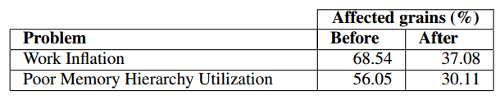
Experiments & Evaluation
Sort has additional problems that can be seen on the grain graph in a mutually exclusive manner. We summarize the problems and optimization results in the table below for space reasons:

Slide 28
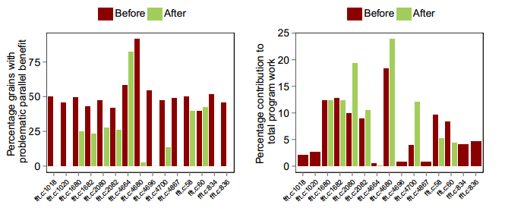
Experiments & Evaluation

Slide 29
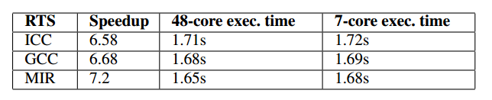
Experiments & Evaluation

Slide 30
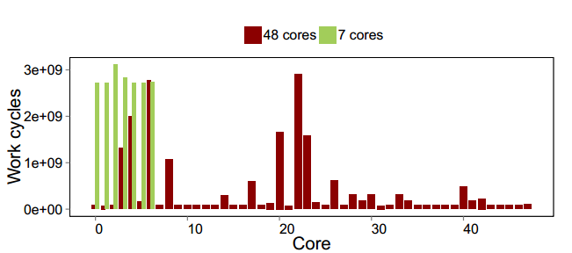
Experiments & Evaluation

Slide 31
OUTLINE
Introduction
Needs for Grain Graphs
Grain Graphs Structure and Metric
Experiments & Evaluation
Conclusions

Slide 32
Conclusions
Grain graphs are independent of profiling method and can be adopted to depict any control-flow that creates and synchronizes asynchronously with explicit, implicit or conceptual tasks.
Large graphs have long rendering times, which is a scalability issue since programmer work flow is iterative.

Slide 33
Thanks & Comments!

